Slide 1
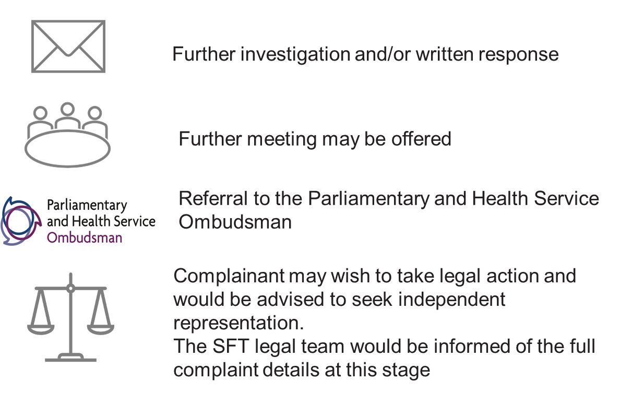







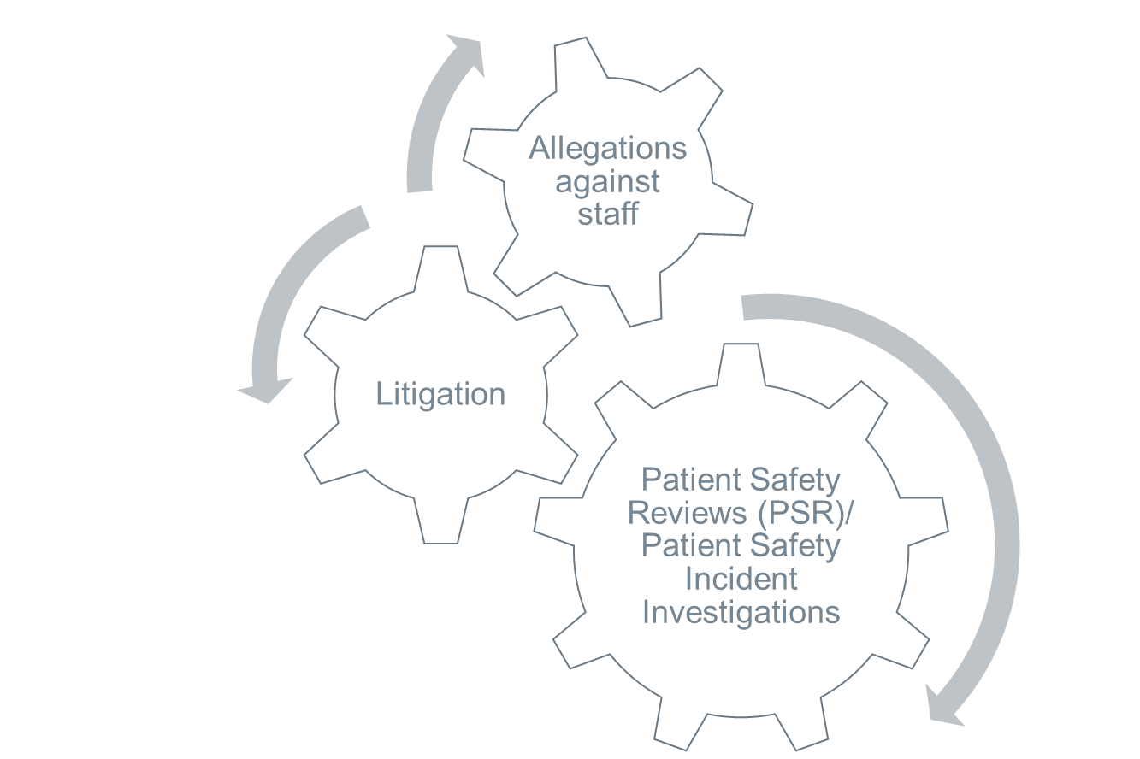
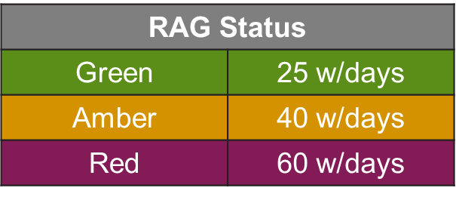


Complaint/ Concern is raised by any method suited to the complainant
Record of discussion is taken; key points and questions determined, and desired outcomes defined
Complaint assigned to a dedicated complaints coordinator.
Allegations against a member of staff are sent to the safeguarding team for review and PALS await instruction to proceed to phase 2 of the process
48hr review to designated complaint leads within the division for completion.
Complaint re-opens
PHASE 1
PHASE 4
Complaint is closed
Template is returned with completed RAG (timescale for response), next actions for investigation and identification of any opportunities for early resolution recorded and completed
Individual complaint response actions are recorded on the Datix system with due dates and responsible persons assigned.
Acknowledgement sent to complainant within 3 working days
Where the response is from the CEO a second review with the Quality Team will take place
Alongside the complaint investigation a safety review (PSR) or incident investigation (PSII) may also run in parallel. This should be considered with the RAG status allocated and both processes should align to address all parts of the complaint and incident
Broader themes and learning are shared at Division Governance Forums and to Trust Board through quarterly patient experience reports.
PHASE 2
PHASE 3
Findings are collated and a final response is drafted.
Alternatively, a meeting may be offered to review the outcomes of the investigation.
Meetings are the preferred option for resolution where possible.
All written responses are reviewed by PALS
Patient stories and improvement projects are developed with the Patient Experience team in response to these broader themes.
Action Plans are agreed
Records review, timelines and witness statements are undertaken, events are reflected upon and learning is identified.
Meeting is held with the complainant
Notes:
48hr template aims
Give more ownership of the management of the complaint to the investigating areas/divisions
RAG rating setting
Early resolution / pick up the phone!
Meeting may not be suitable
Ensuring to link up/highlight any related processes
SI / Allegations against staff/ Litigation
RoD changes = outcome and key points focussed
Team = mediation training, insightful questioning using the GROW model (Goal, Reality, Options, Way Forward)
Review of responses:
Clear explanations
Sincere and non-defensive tone/approach
Covers all points
Minimise use of medical jargon (unless explained)

Slide 2
Patient Safety Reviews (PSR)/ Patient Safety Incident Investigations
Litigation
Allegations against staff

Slide 3




Further investigation and/or written response
Further meeting may be offered
Referral to the Parliamentary and Health Service Ombudsman
Complainant may wish to take legal action and would be advised to seek independent representation.
The SFT legal team would be informed of the full complaint details at this stage
Notes:
PHSO – The Ombudsman makes final decisions on complaints that have not been resolved by the NHS. The service is free for everyone. It is important that you make the complaint as soon as you receive our final response as there are time limits for the Ombudsman to look into complaints.
Reasons complaints re-open
Failure to address all areas of the complaint or key outcome was overlooked/not met
Perceived lack of concern and time/effort put into the response letter* particularly if timescales were also not met
Tone and approach was condescending, defensive, lack of accountability
NO APOLOGY !
Sometimes - just
Further clarification was needed on certain aspects – particular with complex complaints or complaints associated with a bereavement
look into complaints where someone believes there has been injustice or hardship because the organisation has not acted properly or has given a poor service and not put things right. Service is free for everyone but has time limits – strict!! Can also make suggested pay awards.

Slide 4
Categorisation and time scales allocated to complaints
Green – Response in 25 working days.
Delayed appointments or treatment.
No adverse outcome or injury.
Non-complex and 1 or 2 Services involved.
Amber – Response in 40 working days.
Adverse outcome or minor injury noted (which is not subject to an SII, CR or LR)
Complex case +/- involving 2-4 Services
Contact with the media suggested or confirmed
Patient is vulnerable and complainant may suggest neglect or significant failings in care.
Investigating team need additional time due to absence (sick/annual leave) within relevant clinical team
A statement is required form a staff member who no longer works for the Trust or who is employed by an Agency.
Red - Response in 60 working days.
Adverse outcome or SII, CR or LR running alongside the complaint.
Very complex and involving more than 4 Services
Contact with the media confirmed / suggested
Patient is vulnerable and complainant suggests neglect or abuse by staff.
GREEN
Response in 25 working days
AMBER Response in 40 days
RAG Status
Green | 25 w/days
Amber | 40 w/days
Red | 60 w/days
RED
Response in 60 days

Slide 5
Flowchart: Managing Cross Boundary Complaints
Acknowledge within 3 working days and process under usual complaints procedure
No
Copy of the final response should be shared with all organisations involved to evidence complaint closure
Is another organisation referenced in the complaint?
Acknowledge and seek consent to share with other organisation within 3 working days
Identify and separate out issues and areas of responsibility for each organisation. Decide which organisation will lead.
Agree milestones and timescale for response and complainant.
Draft response shared between organisations and final response agreed
Lead organisation sends response to complainant
Complaint/ Concern is raised by any method suited to the complainant
Yes
Lead organisation will take responsibility for updating complainant on progress of their complaint

